Slide 1
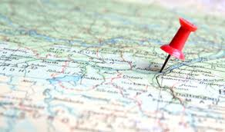
Comparison of Free Online Mapping Tools
Rebecca Bartlett – GIS and Digital Resources Librarian
Joël Rivard – Cartographic Specialist
Carleton University Library – Maps, Data & Government Information Centre

Slide 2
“Friendly” Olympic-themed competition

Slide 3
Arbitrarily assigned 6 free online mapping tools

Slide 4
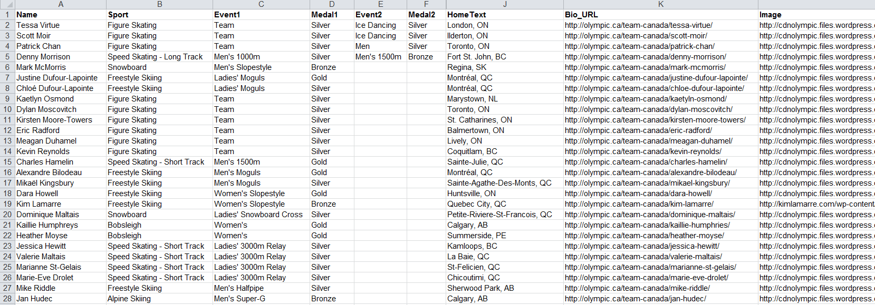
2014 Canadian Olympic medalists and their home towns
83 athletes in total (including 4 multi-medalists) from 61 home towns
Data from http://olympic.ca/

Slide 5
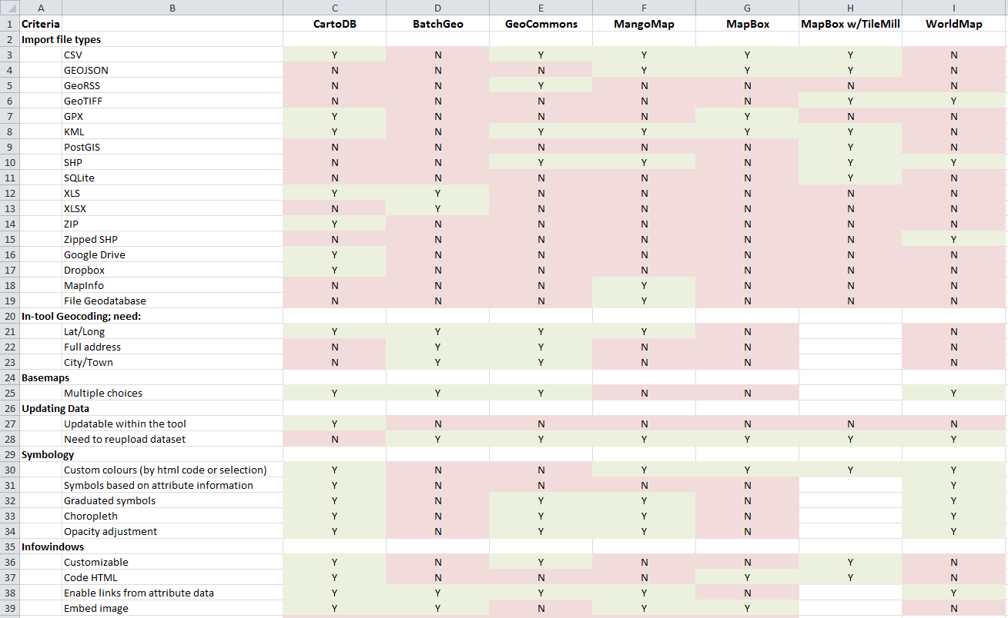
Tracked a variety of criteria for each of the 6 tools
Import file types
In-tool geocoding
Basemaps
Updating data
Symbology
Information windows
Time series
Publish Map
Export file types

Slide 6
Overview of individual tools

Slide 7
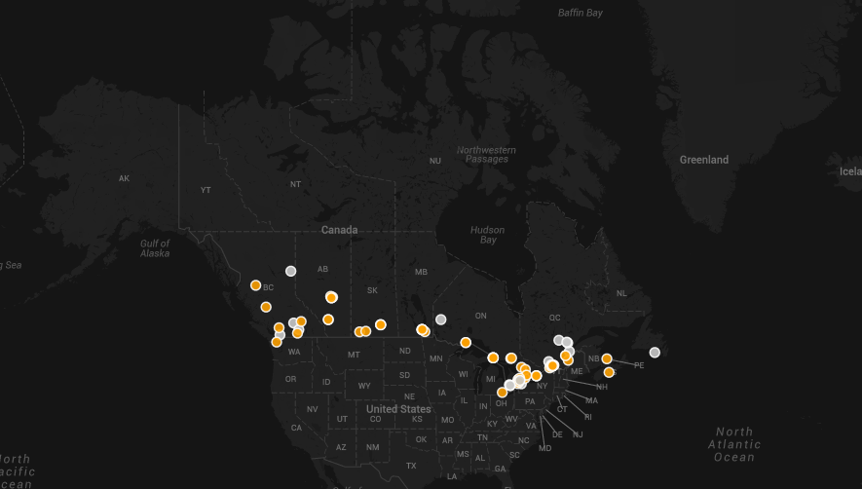
http://cdb.io/1ikyKDt

Slide 8
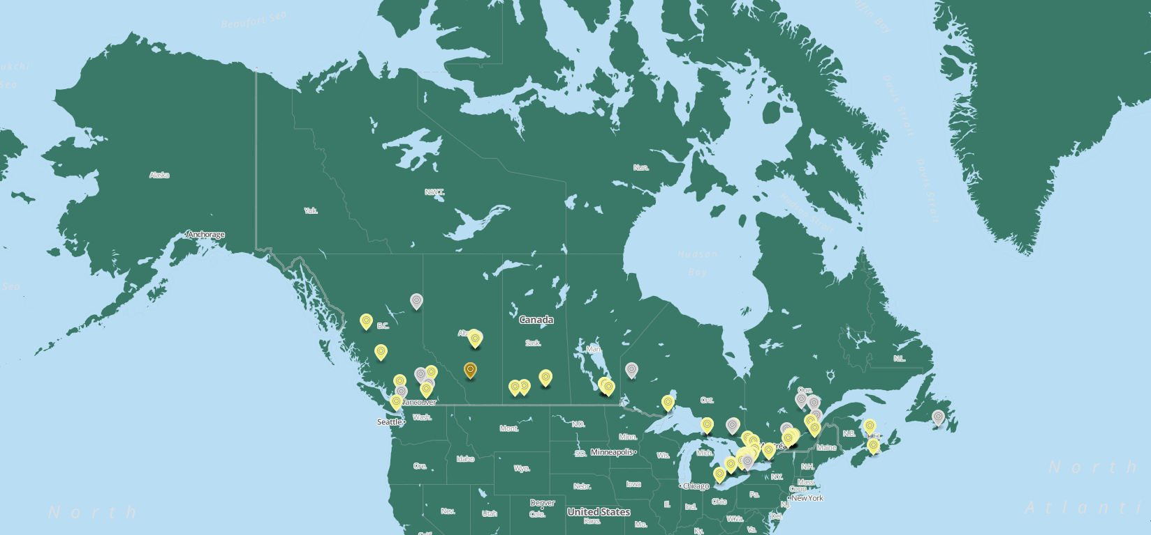
https://a.tiles.mapbox.com/v3/bartlettr.hci5ie6j/page.html#4/57.59/-90.09

Slide 9
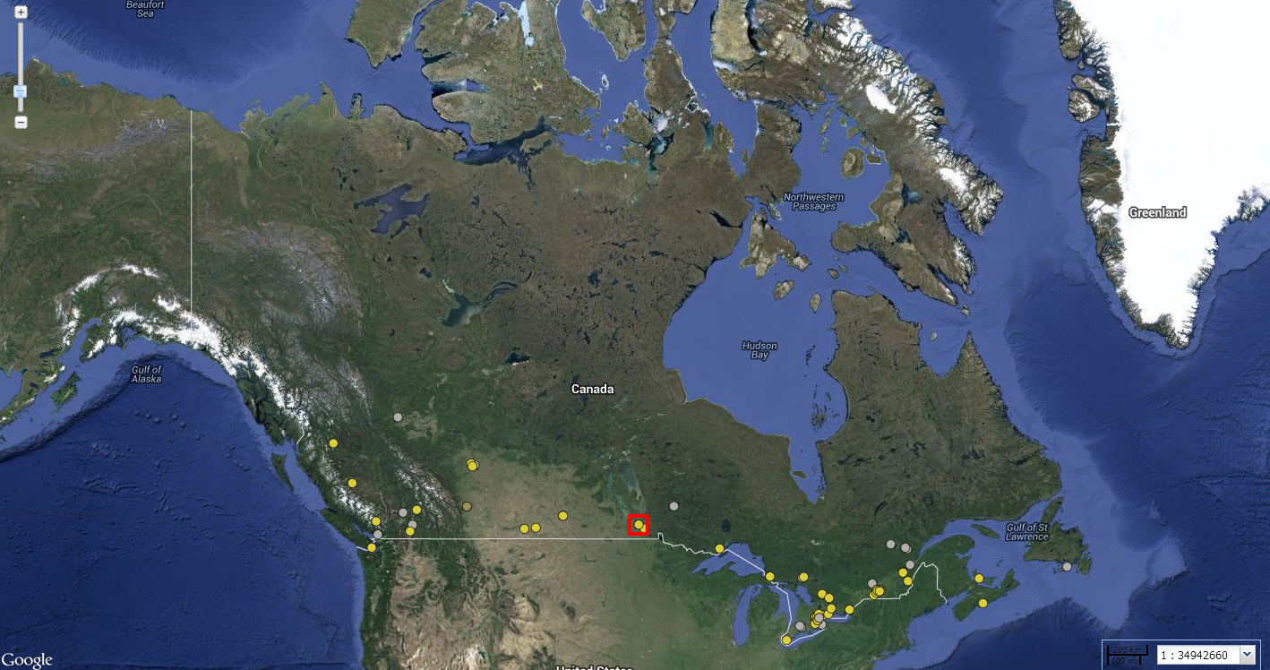
http://worldmap.harvard.edu/maps/CanadianMedals2014/K8G

Slide 10
Edit Online Map

Slide 12
MangoMap

Slide 13
In-tool Geocoding
Tool | Lat/Long | City name | Street address
BatchGeo
CartoDB
GeoCommons
MangoMap
Mapbox
WorldMap

Slide 14
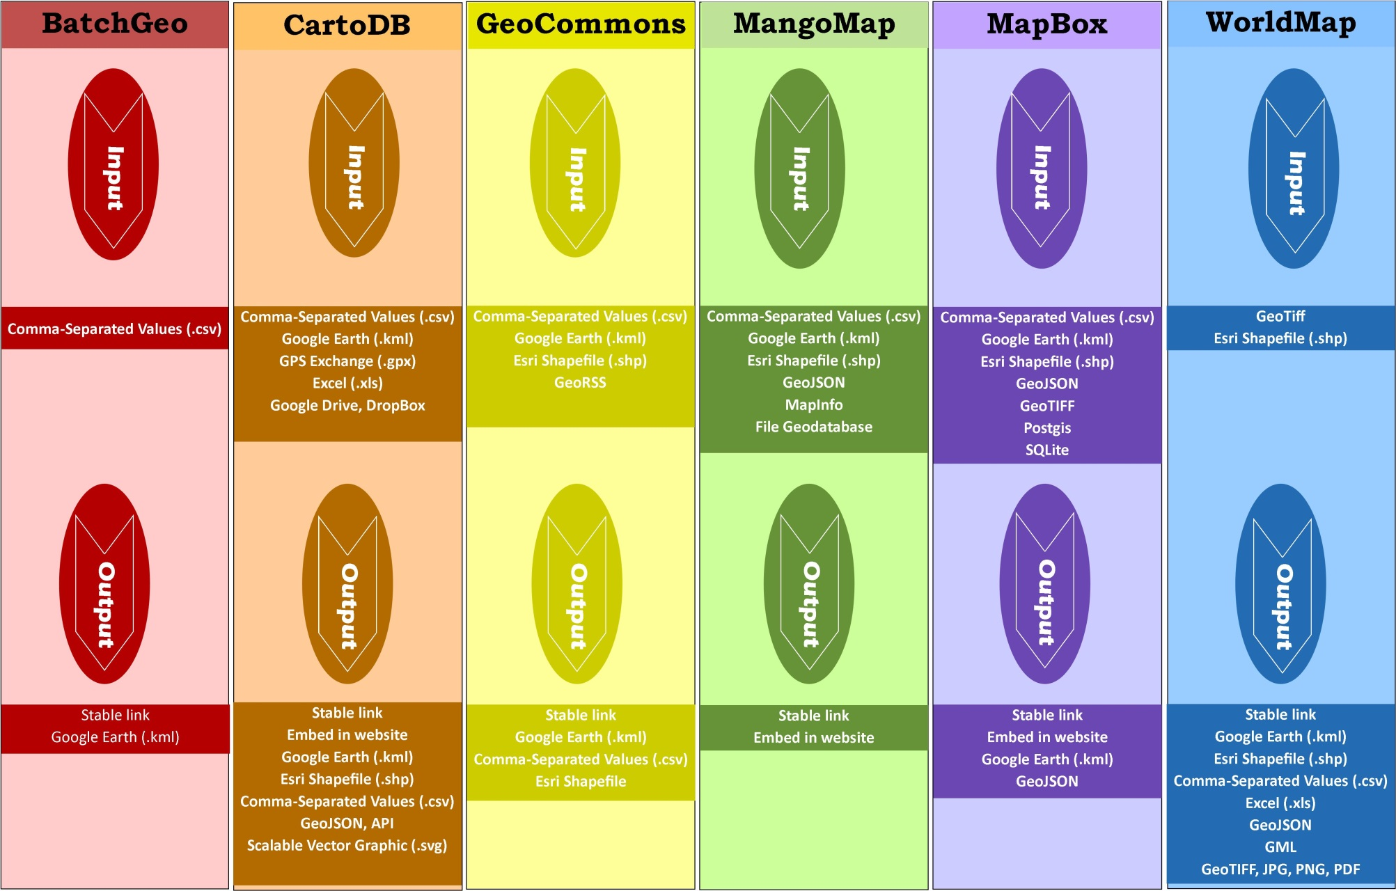
Input and Output

Slide 15
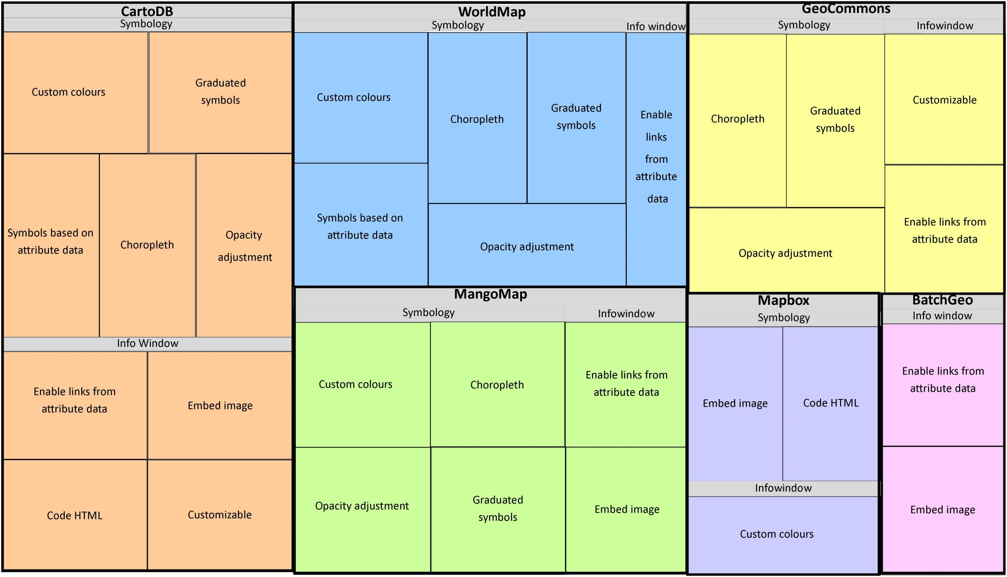
Customizing Symbology and Information Windows

Slide 16
Thank you
Questions?

