Slide 1
Use of LiDAR, RADARSAT, & WorldView-2 for Showing Inundation Extents, Impacts & Drainage Structures
Cynthia Dietz, & Greg McCullough, U Manitoba
Michael Stainton, Fisheries and Oceans Canada
Notes:
As GIS Environmental Studies Librarian at UM, I am eager to address current problems in the Province when introducing patrons to functions of GIS and remote sensing software through workshops. Flooding and issues pertaining to the delivery of pollutants to Lake Winnipeg, noted….., are topics being addressed by the University and provincial and federal agencies alike. Collaborations with… have and are developing and strengthening.

Slide 2
LaSalle River Basin Study Area near Winnipeg, Lake Manitoba & Lake Winnipeg
Notes:
Winnipeg and nearby regions are impacted by almost annual flooding and or snow melt events. Winnipeg is the regional low in the landscape, and the location of joining of two major rivers: the Red River of the North and the Assiniboine R. Notice two of Manitoba’s great lakes…The area outlined in red is the capture area of a WorldView-2 satellite scene, A Digital Globe product, purchased by the library.

Slide 3
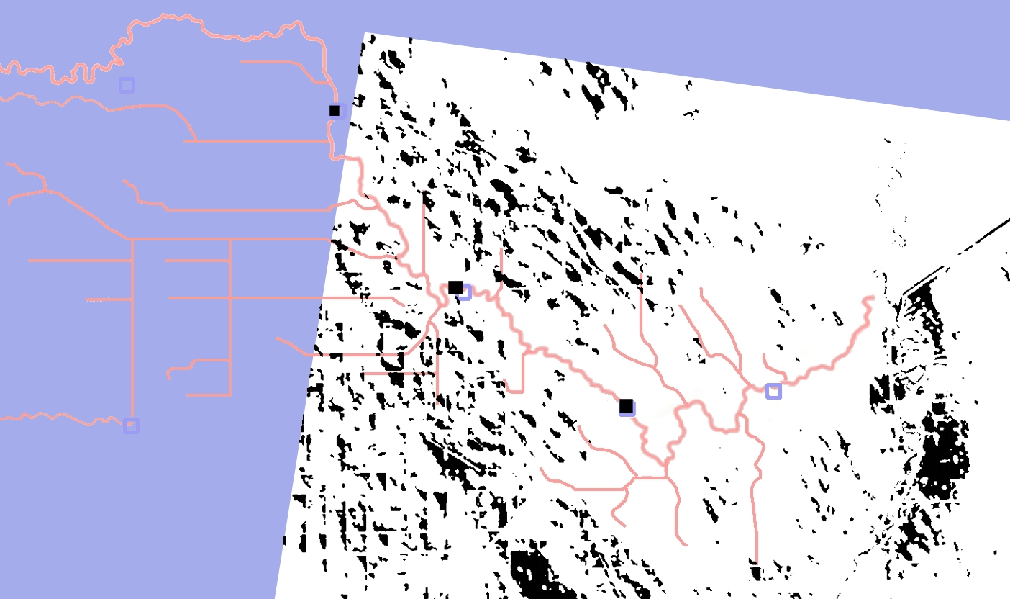
La Salle Inundated Land 2009 : April 14c
Notes:
The study area selected is a subwatershed of the LaSalle River watershed. The terrain, being so flat, typically is a site of snow melt ponds and flood waters. Note the ponding to the NW of the scene. Note the density of water from the flooded Red River and its tributaries to the south.

Slide 4
La Salle Inundated Land 2009: April 17c
Notes:
Just three days later, note the progression of flood waters from the south. The density of snow melt ponds has diminished. Note how our area of interest is flooded.

Slide 5
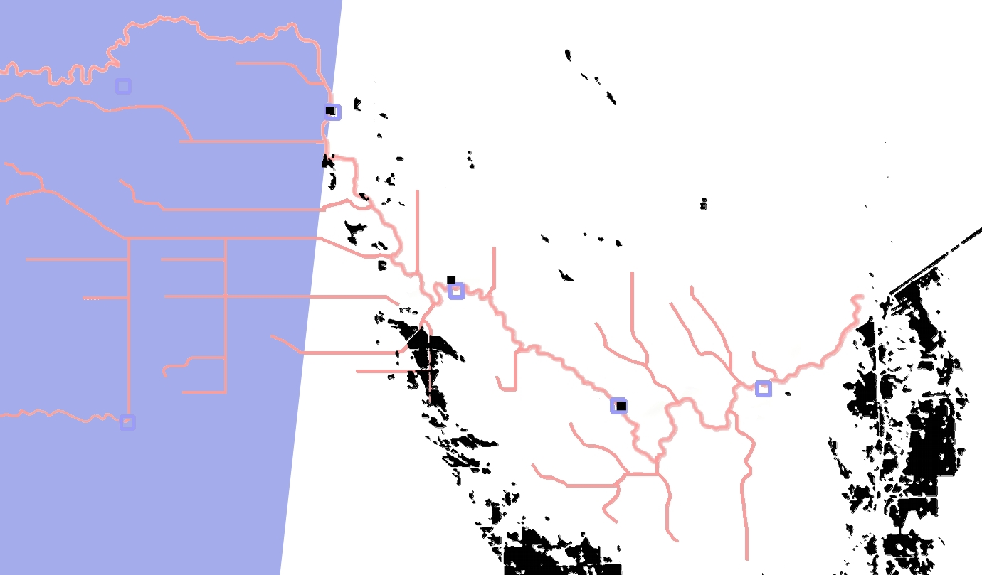
La Salle Inundated Land 2009: April 24c
Notes:
Here, a week after the last image, snow melt waters are significantly reduced, while the flood waters have started to recede.

Slide 6
Research Interests
Description of drainage facilities and issues
Do flood diversions and snow melt show patterns year to year?
Are drainage features sufficiently robust?
Are LiDAR studies adequate to capture the volume of inundating water and snow melt features?
How does standing water contribute to the loading of dissolved phosphorus to Lake Winnipeg?
How can soil moisture studies be used?
What is the extent of geomorphological changes created by farmers interested in getting water off their land quickly?

Slide 7
Some Remote Sensing Products Used
Year | WorldView-2 | RADARSAT derivatives | LiDAR
2009 |  | April 12, April 19 | LaSalle sub-watershed: May 6-23
2010 | Digital Globe via ESRI: Aug. 2
2011 |  | April 8, 11, 15
2012 |  |  | Elm Creek sub-watershed: Sept. 29-Oct. 16
2013 | Digital Globe via UManitoba: 8-band bundle, Nov. 2

Slide 8
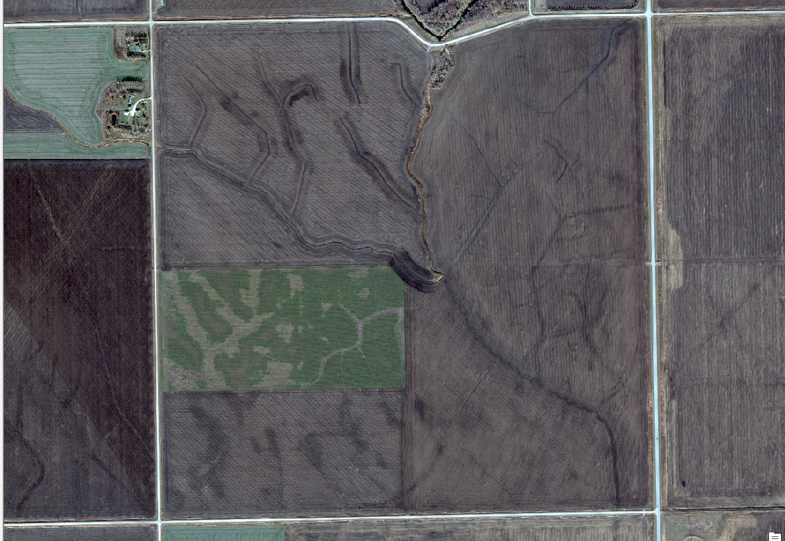
LaSalle River Basin Study Area, Nov. 2, 2013: via WorldView-2

Slide 9
La Salle River Basin Flooding: Early April, 2011
Notes:
Note that standing water on April 8th appears black, while the standing water of April 15th is lilac. Where standing water from both dates overlap, the color represented on the map is dark blue.The grey/clack polygons tend to be scattered, while the lilac ones tend to progress from the south, suggesting indudations from the Red River watershed. Note the location of our study area.

Slide 10
La Salle River Basin Flooding: Later April, 2011

Slide 11
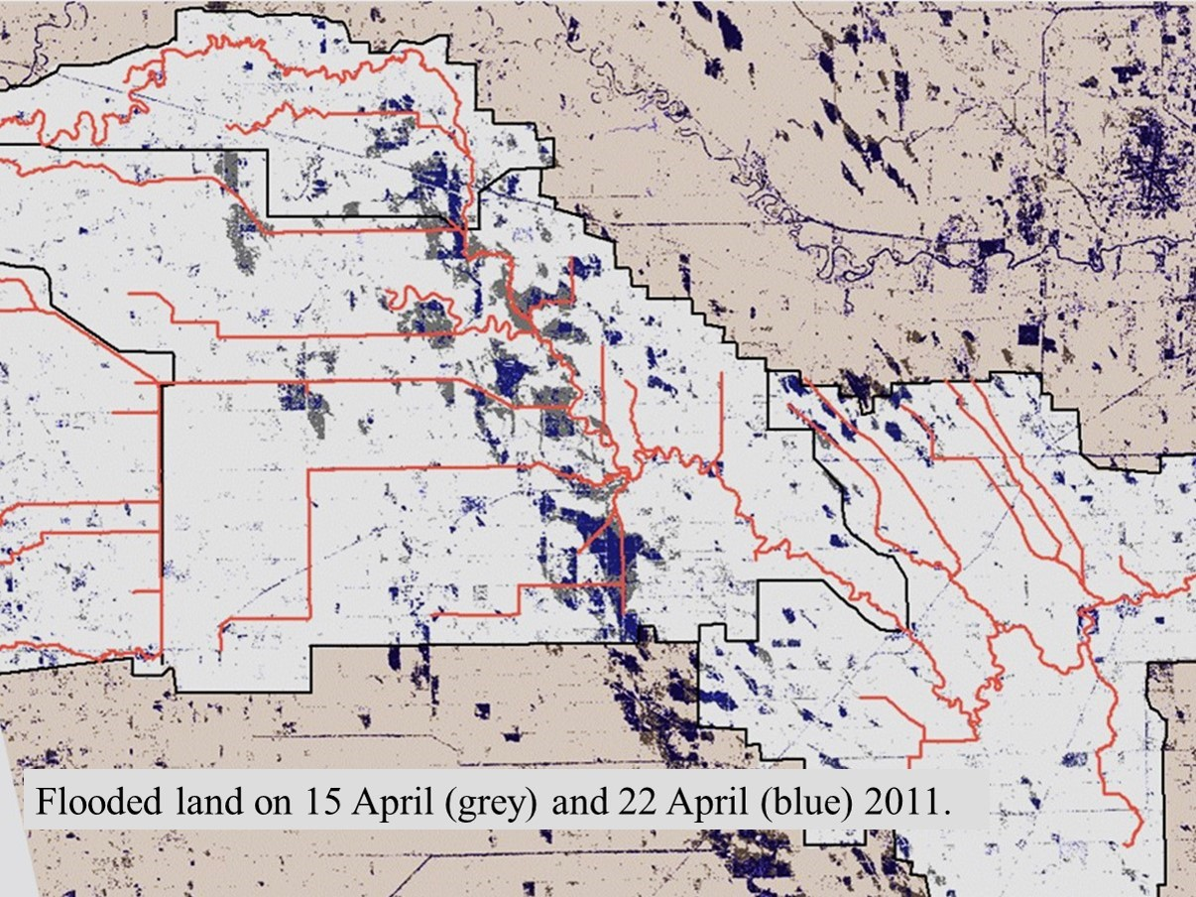
La Salle River Basin Flooding: Sequence
Notes:
Almost two weeks later, again note the location or our study area. Also note how the standing waters to the West have discipated.

Slide 12
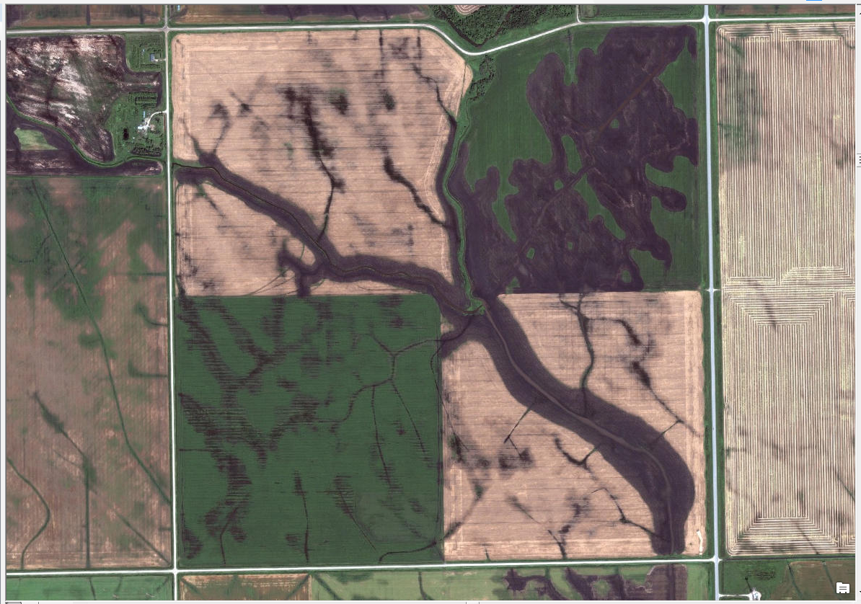
Study Area, August 2, 2010
Courtesy of ESRI basemaps- WorldView-2 image

Slide 13
Study Area, Nov. 2, 2013
WorldView2 image Courtesy of U. of Manitoba Libraries

Slide 14
Soil Moisture Index Using a Normalized Difference Water Index (NDWI) in Geomatica 2013*
See Wolf, A. (2010) Using WorldView 2 Vis-NIR MSI Imagery to Support Land Mapping and Feature Extraction Using Normailized Difference Index Ratios;
Equation from http://landmap.ac.uk/index.php/Learning-Materials/PCI-Geomatica/Page-2

Slide 15
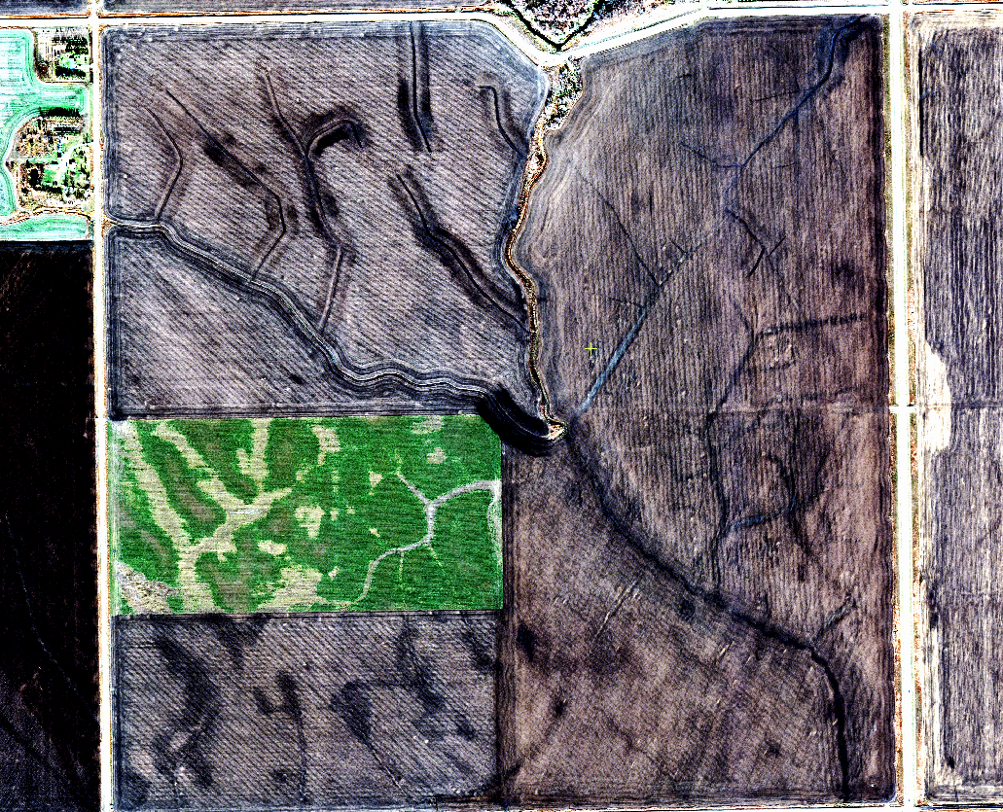
Is soil moisture where you would expect it?

Slide 16
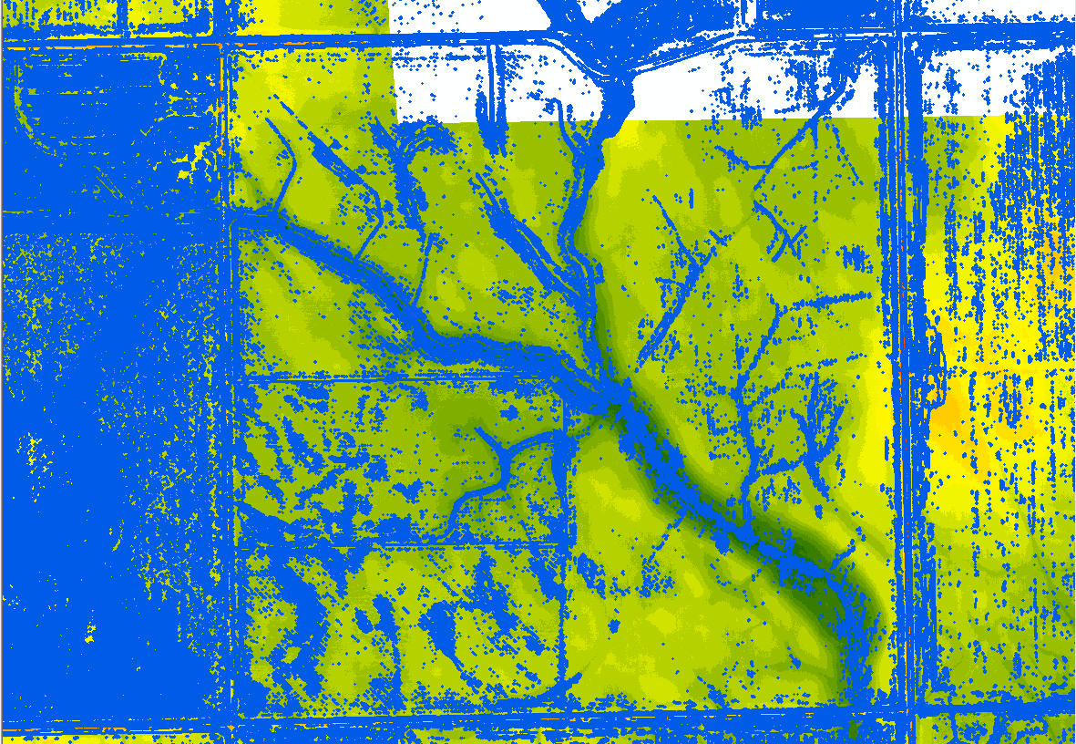
Shapefile LaSallePix2Poly (2013): & Overlay on LiDAR, 2012

Slide 17
2009 La Salle R. Discharges: Spring

Slide 18
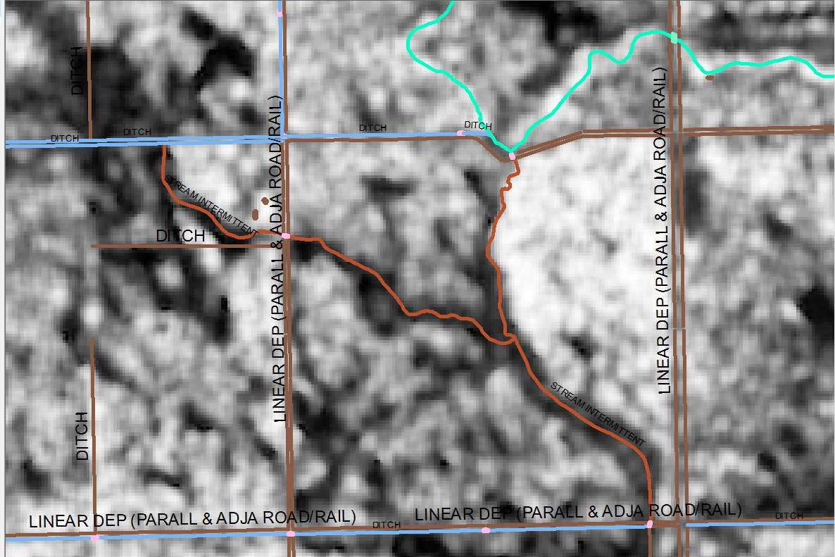
What are the local impacts as seen using RADARSAT-1 on April 12, 2009?

Slide 19
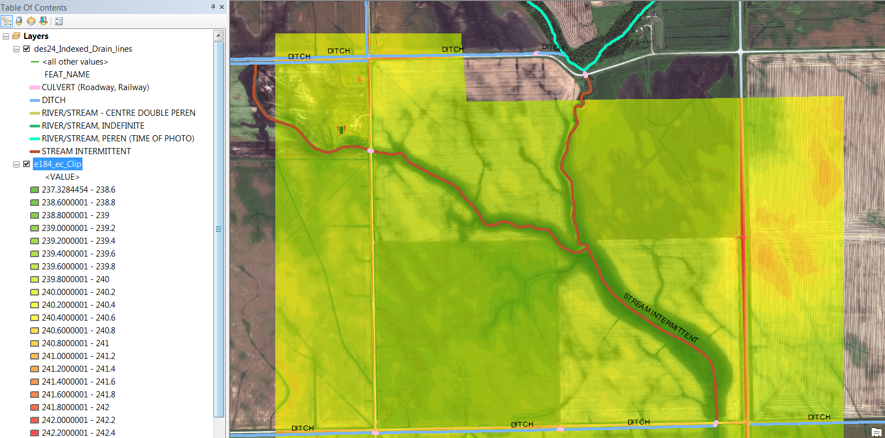
What can we tell about the terrain from a LiDAR generated DEM from 2009? Note drainage features.

Slide 20
RADARSAT-1, April 12, 2009
Snowmelt draining into La Salle River

Slide 21
RADARSAT-1, April 19, 2009

Slide 22
RADARSAT-1, April 19, 2009
Flood water from mainstem of La Salle
Overland flow
(returns to river 2 mi. S)

Slide 23
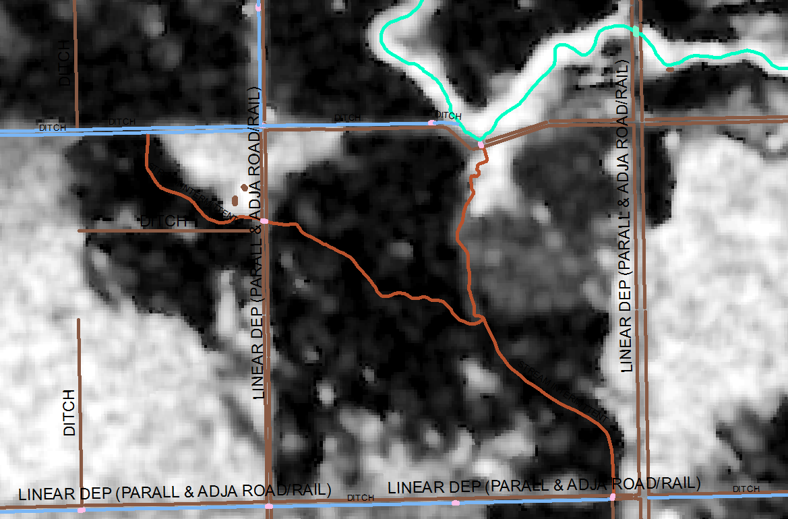
Classification overlay generated from April 19, 2009 RADARSAT-1 Image

Slide 24
2011 La Salle River Discharges: Spring

Slide 25
RADARSAT-2, April 8, 2011

Slide 26
RADARSAT-2, April 11, 2011

Slide 27
RADARSAT-2, April 15, 2011

Slide 28
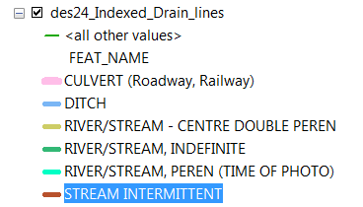
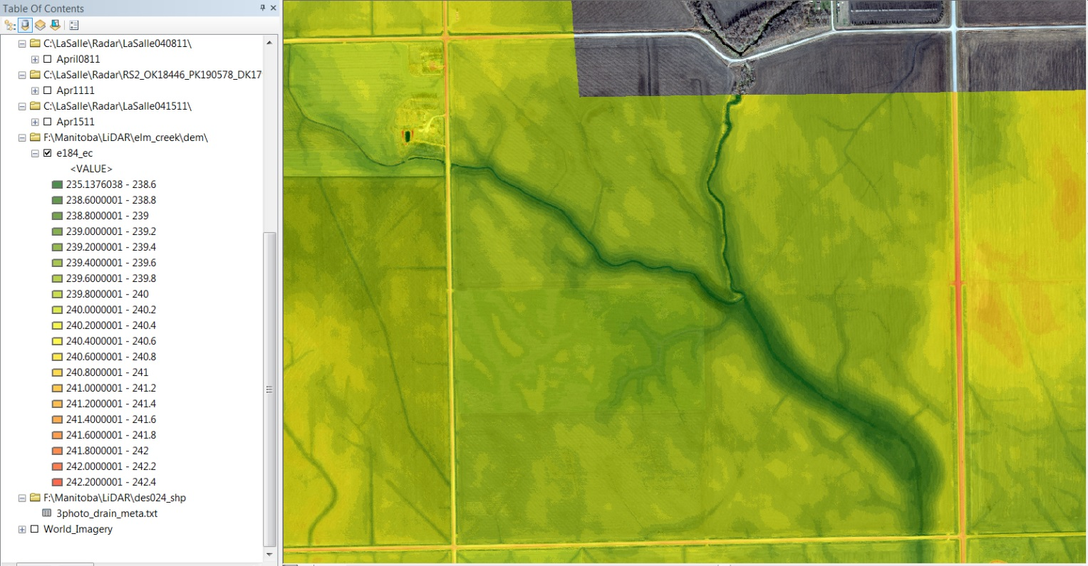
Are Drains Located Appropriately?
2012

Slide 29
Infield Drainage Structures in 2013 via WorldView-2

Slide 30
Farmer’s Drains via WV-2 Pan-Sharpened NIR Band

Slide 31
NWDI Index Shapefile (2013) Overlay on LiDAR, 2012

Slide 32
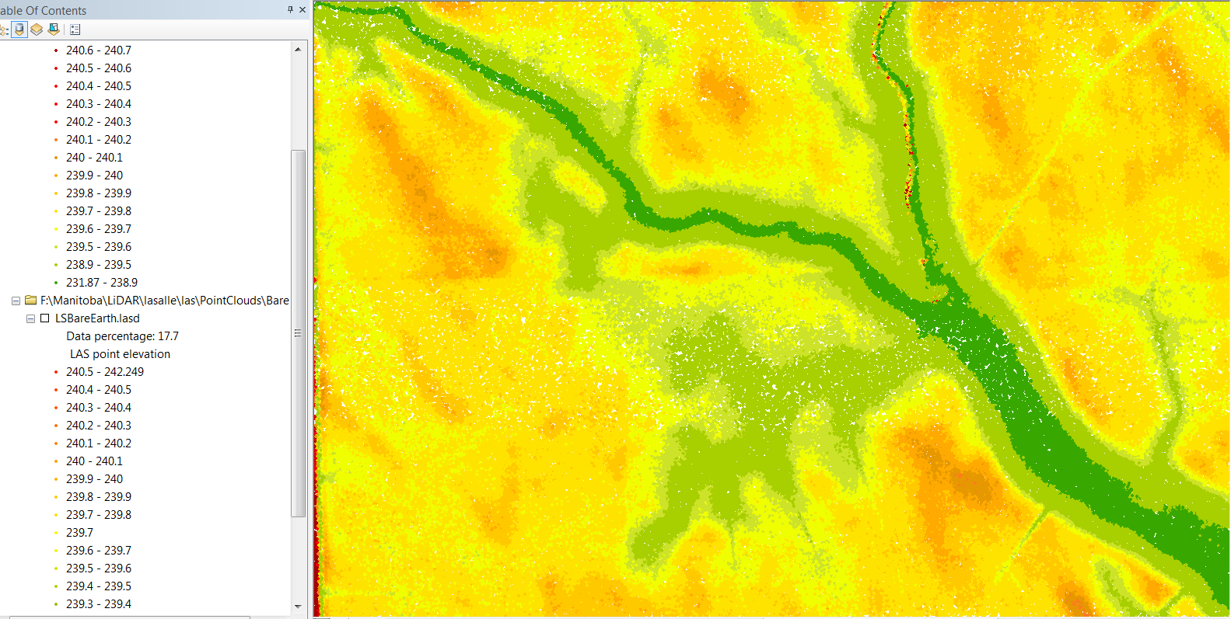
Are LiDAR products consistent enough to calculate Surface Water Volumes?
Without LaSalle Point Cloud
With LaSalle Point Cloud Overlay

Slide 33
Surface & Volume Calculations for Area of Interest at Potential Flood Elevation of 239.84m

Slide 34
Educational Opportunities, Part 1
Use remote sensing products to begin to develop site-specific management alternatives at the landscape level.
For areas of interest, estimate the habitat carrying capacity.
For areas of interest, estimate the drainage density, or the
total length of streams/ drainage area.

Slide 35
Educational Opportunities, Part 2
LiDAR workshops/tools:
From Water Resources Center, U of Minnesota http://wrc.umn.edu/randpe/agandwq/tsp/lidar/LiDARTrainingMaterials/index.htm
From NRCS, Minnesota ftp://ftp.lmic.state.mn.us/pub/data/elevation/lidar/tools/NRCS_engineering/ENGINEERING_TOOLS_WORKFLOW.pdf
U Manitoba Workshops:
Methods in analyzing Worldview-2 and RADARSAT in PCI Geomatica
Methods in analyzing LiDAR in ArcGIS Desktop 10.1 & 10.2
Select Geoprocessing Tools in ArcGIS

Slide 36
Questions?

